Slide 1
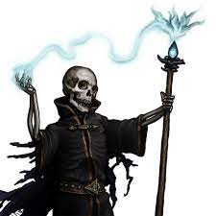
The Night of the Liche
Pitch Date: 12/18/2022 Update 2/19/2023
Release Date: 4/9/2023 174 Commits (+39)
Team Lead: Vince McKeown 11 Contributors (+1)
1
2
3
4
5
6
7
8
9
10
11
12
13
14
15
16

Slide 2
Vince McKeown
WIP on leaves blowing across screen
Liche added into the game and animated facing South

Slide 3
Tylor Allison
Integrated Stove Art

Slide 4
H Trayford
WIP on thoughts not leaving the screen

Slide 5
Christer “McFunkyPants” Kaitila
Rain now falls everywhere

Slide 6
Carsair
Refactored input code (key bind, reduced redundancy)
Updated user input information on main screen
Added Pause function

Slide 7
Muzz1992
Added Guard and Blacksmith

Slide 8
jhruvphysics
Improved readability of health
Fixed player sword direction
Fixed Enemy direction

